Slide 1
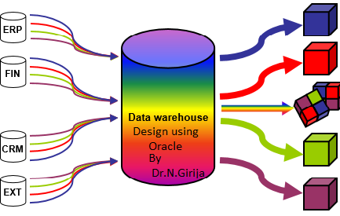
Data warehouse Design Using Oracle
https://www.oercommons.org/authoring/edit/21861
OER- UNIT 4 PARTITION
Dr. Girija Narasimhan

Slide 2
PARTITION
TABLESPACE
Dr.Girija Narasimhan

Slide 3
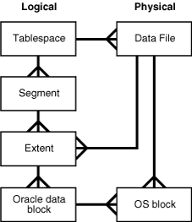
Oracle Database allocates logical space for all data in the database.
The logical units of database space allocation are data blocks, extents, segments, and tablespaces.
At a physical level, the data is stored in data files on disk
The data in the data files is stored in operating system blocks.
Dr.Girija Narasimhan

Slide 4
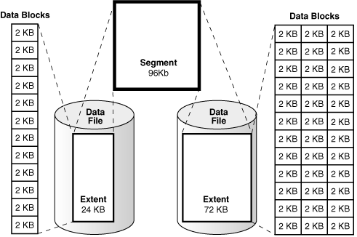
Data blocks are the smallest units storing data in the oracle database
An extent is a set of logically contiguous data blocks allocated for storing a specific type of information
A segment is a set of extents allocated for a specific database object, such as a table.
Each segment belongs to one and only one tablespace
Dr.Girija Narasimhan

Slide 5
The database has one or more table space.
Table space is called as logical storage unit within an oracle database.
The meaning of logical is table space is not visible in the file system.
Table space has at least had one data file. Each table space has unique data file.
Each table space is divided into based on the size mentioned in the “Create tablespace” statement.
The table space builds the bridge between the oracle database and the file system in which the table’s or index data is stored
Dr.Girija Narasimhan

Slide 6
CREATE TABLESPACE dwuser01a
DATAFILE 'c:\temp\dwuser1a.dbf' SIZE 40M
BLOCKSIZE 8192
EXTENT MANAGEMENT LOCAL UNIFORM SIZE 256K
SEGMENT SPACE MANAGEMENT AUTO ONLINE;
In the Lab session students are sharing single server, then each user created different dbf file in the c:\temp- otherwise “already .dbf” file exist error will occur.
For example: ‘c:\temp\user1.dbf’. .c:\temp\user2.dbf’
Dr.Girija Narasimhan

Slide 7
DROP TABLE SPACE
Dr.Girija Narasimhan

Slide 8
You can drop a tablespace and its contents (the segments contained in the tablespace) from the database if the tablespace and its contents are no longer required
Once a tablespace has been dropped, the data in the tablespace is not recoverable.
Therefore, make sure that all data contained in a tablespace to be dropped will not be required in the future
SQL> drop tablespace ica;
This will drop the tablespace only if it is empty
Dr.Girija Narasimhan

Slide 9
Tablespace is not empty and if you want to drop it anyhow then add the following keyword
SQL>drop tablespace ica including contents;
This will drop the tablespace even if it is not empty.
But the data files will not be deleted you have to use operating system command to delete the files.
But If you include data files keyword then, the associated data files will also be deleted from the disk.
SQL>drop tablespace ica including contents and datafiles;
Dr.Girija Narasimhan

Slide 10
various types of partition
Dr.Girija Narasimhan

Slide 11
CREATE TABLE <Table name>
Partition Type
Partition Type
Partition Type
RANGE PARTITION
LIST PARTITION
HASH PARTITION
COMPOSITE PARTITION
RANGE PARTITION
Using Number Values
RANGE PARTITION
Using Alphabet Values
RANGE PARTITION
Using DATE Values
Dr.Girija Narasimhan

Slide 12
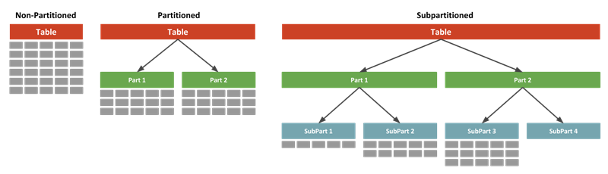
Dr.Girija Narasimhan

Slide 13
RANGE PARTITION
Using Number Values
Dr.Girija Narasimhan

Slide 14
create table interval_part(pid number(5) not null,
fname varchar2(30),
lname varchar2(30) )
partition by range(pid)
(
partition p1 values less than(101)
)
tablespace dwuser01a;
PARTITION TYPE
COLUMN NAME
PARTITION NAME
Insert values into the interval_part and check whether the records are storing in the assign partition
Insert into INTERVAL_PART values(100,’Ali’,’Ahmed’);
Insert into INTERVAL_PART values(101,’Zahra’,’Khamis’);
As per given condition, the maximum value is 100, it will store only the first record only. It will give error message, for the value of product id 101 no partition was assigned
Dr.Girija Narasimhan

Slide 15
Insert into interval_part values(101,'zahra','khamis') * ERROR at line 1: ORA-14400: inserted partition key does not map to any partition
The USER_TAB_PARTITIONS describes the partition information as name of the partition, tablespace name, storage parameter or value range of the partition .
SELECT PARTITION_NAME, TABLESPACE_NAME, HIGH_VALUE FROM USER_TAB_PARTITIONS;
PARTITION_NAME TABLESPACE_NAME HIGH_VALUE ----------------------------------------------------------------------------- P1 dwuser01a 101
Display the values stored in the partition.
SELECT * FROM INTERVAL_PART PARTITION(P1);
PID FNAME LNAME ---------- --------------- ----------------- 100 Ali Ahmed
Dr.Girija Narasimhan

Slide 16
RANGE PARTITION
Using Alphabet Values
Dr.Girija Narasimhan

Slide 17
Create table product_alpha(Pid number(4) primary key , pname varchar2(25),pcategory varchar2(20))
PARTITION BY RANGE(pcategory)(
Partition pcategoy_ae VALUES LESS THAN(‘F%’) TABLESPACE part1,
Partition pcategoy_fl VALUES LESS THAN(‘M%’) TABLESPACE part2,
Partition pcategoy_mr VALUES LESS THAN(‘S%’) TABLESPACE part3,
Partition pcategoy_sz VALUES LESS THAN(MAXVALUE) TABLESPACE part4);
It will store the values “a,b,c,d,e”
It will store the exceed values of all the partition
Store each partition in different tablespace
Range partition using partition key based on character based values.
This type of partition is useful for based on location name, country and supplier based analysis in the data warehousing.
This is the alternative to numeric based values.
Dr.Girija Narasimhan

Slide 18
SELECT PARTITION_NAME,TABLESPACE_NAME,HIGH_VALUE FROM USER_TAB_PARTITIONS;
PARTITION_NAME TABLESPACE_NAME HIGH_VALUE ----------------------------- -------------------------------- ------------------- PCATEGOY_SZ PART4 MAXVALUE PCATEGOY_AE PART1 'F%' PCATEGOY_FL PART2 'M%' PCATEGOY_MR PART3 'S%‘
Insert into Product_alpha values(100,’Sony LCD 32”’,’TV’); Insert into Product_alpha values(200,’Sony POWER SHOT’,’CAMERA’); Insert into Product_alpha values(300,’Sony 3G Dual SIM’,’MOBILE’); Insert into product_alpha values(400,’Cannon Digit power’, ’DIGITAL CAMERA’);
Dr.Girija Narasimhan

Slide 19
SELECT * FROM Product_alpha PARTITION(PCATEGOY_AE);
PID PNAME PCATEGORY ---------- --------------------------- -------------------- 200 Sony POWER SHOT CAMERA 400 Cannon Digit power DIGITAL CAMERA
SELECT * FROM Product_alpha PARTITION(PCATEGOY_FL);
no rows selected
SELECT * FROM Product_alpha PARTITION(PCATEGOY_MR);
PID PNAME PCATEGORY ---------- ------------------------- -------------------- 300 Sony 3G Dual SIM MOBILE
SELECT * FROM Product_alpha PARTITION(PCATEGOY_SZ);
PID PNAME PCATEGORY --------- ------------------------- -------------------- 100 Sony LCD 32” TV
Dr.Girija Narasimhan

Slide 20
RANGE PARTITION
Using DATE Values
Dr.Girija Narasimhan

Slide 21
The partition key in the range partition to be Date based.
It is useful for analyzing table data week wise or day wise.
Store values upto 31-dec-2006
CREATE TABLE Productrange_date (
Pid number(4) Primary key,pname varchar2(25),expdate date NOT Null)
PARTITION BY RANGE(expdate)(
PARTITION yr0 VALUES LESS THAN (TO_DATE('01-JAN-2007','DD-MON-YYYY')) TABLESPACE part1,
PARTITION yr1 VALUES LESS THAN (TO_DATE('01-JAN-2008','DD-MON-YYYY')) TABLESPACE part2,
PARTITION yr2 VALUES LESS THAN (TO_DATE('01-JAN-2009','DD-MON-YYYY')) TABLESPACE part3,
PARTITION yr3 VALUES LESS THAN (MAXVALUE) TABLESPACE part4);
INSERT INTO Productrange_date VALUES (1001, ‘Orange’, ’21-MAY-08’); INSERT INTO Productrange_date VALUES (1002, ‘Sugar’, ’16-MAY-09’); INSERT INTO Productrange_date VALUES (1003, ‘Biscuit’, ’12-NOV-09’);
SQL> select * from productrange_date; PID PNAME EXPDATE ---------- ------------------------- ------------- 1001 Orange 21-MAY-08 1002 Sugar 16-MAY-09 1003 Biscuit 12-NOV-09
Dr.Girija Narasimhan

Slide 22
SELECT * FROM productrange_date PARTITION(yr1);
no rows selected
SELECT * FROM productrange_date PARTITION(yr2); PID PNAME EXPDATE ---------- -- ------------- ------------- 1001 Orange 21-MAY-08
SELECT * FROM productrange_date PARTITION(yr3); PID PNAME EXPDATE --------- --------------- ------------- 1002 Sugar 16-MAY-09 1003 Biscuit 12-NOV-09
Dr.Girija Narasimhan

Slide 23
ALTER TABLE
ADD PARTITION
Dr.Girija Narasimhan

Slide 24
ADD PARTITION
RANAME PARTITION
ALTER TABLE <Table name>
MERGE PARTITION
DROP PARTITION
Dr.Girija Narasimhan

Slide 25
ADD PARTITION
Using Alter table – ADD Partition statement, it is possible to insert new partition details of already existed partition
Alter table INTERVAL_PART ADD partition p2 values less than(201);
SELECT PARTITION_NAME,TABLESPACE_NAME,HIGH_VALUE FROM USER_TAB_PARTITIONS;
PARTITION_NAME TABLESPACE_NAME HIGH_VALUE -------------------------- ---------------- ----------------- P1 UWDATA 101 P2 UWDATA 201

Slide 26
SELECT * FROM INTERVAL_PART;
PID FNAME LNAME ---------- ------------------------- -------------- 100 Ali Ahmed 101 Zahra Khamis 200 Mohammed Omar
SELECT * FROM INTERVAL_PART partition(P1);
PID FNAME LNAME ---------- ------------------------- -------------- 100 Ali Ahmed
SELECT * FROM INTERVAL_PART partition(P2);
PID FNAME LNAME ---------- ------------------------- -------------- 101 Zahra Khamis 200 Mohammed Omar

Slide 27
ALTER TABLE
RENAME PARTITION
Dr.Girija Narasimhan

Slide 28
ALTER TABLE INTERVAL_PART RENAME PARTITION P1 TO P9;
SQL> SELECT partition_name FROM user_tab_partitions WHERE PARTITION_NAME='P9'; PARTITION_NAME -------------------------- P9
SQL> SELECT * FROM INTERVAL_PART partition(P9); PID FNAME LNAME ---------- -------------- --------------- 100 Ali Ahmed

Slide 29
ALTER TABLE
MERGE PARTITION
Dr.Girija Narasimhan

Slide 30
SELECT * FROM productrange_date PARTITION(yr2); PID PNAME EXPDATE ---------- -- ------------- ------------- 1001 Orange 21-MAY-08
SELECT * FROM productrange_date PARTITION(yr3); PID PNAME EXPDATE --------- --------------- ------------- 1002 Sugar 16-MAY-09 1003 Biscutt 12-NOV-09
Merge partition creates a new partition called yr6
It copies the values from yr2 and yr3
Alter table productrange_date merge partitions yr2,yr3 into partition yr6;
SELECT * FROM productrange_date PARTITION(yr6)
PID PNAME EXPDATE --------- ------------------ --------- 1001 Orange 22-MAY-08 1002 Sugar 16-MAY-09 1003 Biscutt 12-NOV-09
Dr.Girija Narasimhan

Slide 31
ALTER TABLE
DROP PARTITION
Dr.Girija Narasimhan

Slide 32
SELECT * FROM Product_alpha;
PID PNAME PCATEGORY ---------- ----------------------------- -------------------- 200 Sony POWER SHOT CAMERA 400 Cannon Digit power DIGITAL CAMERA 300 Sony 3G Dual SIM MOBILE 100 Sony LCD 32" TV
SELECT * FROM Product_alpha PARTITION(PCATEGOY_AE);
PID PNAME PCATEGORY ---------- --------------------------- -------------------- 200 Sony POWER SHOT CAMERA 400 Cannon Digit power DIGITAL CAMERA
Alter table Product_alpha drop partition pcategoy_ae;
Dr.Girija Narasimhan

Slide 33
it merely updates the data dictionary to indicate that the pcategoy_AE partition no longer belongs to the Product_alpha table.
It also remove the partition values from the table.
SELECT * FROM Product_alpha;
PID PNAME PCATEGORY ---------- ----------------------------- -------------------- 300 Sony 3G Dual SIM MOBILE 100 Sony LCD 32" TV
Dr.Girija Narasimhan

Slide 34
LIST PARTITION
Dr.Girija Narasimhan

Slide 35
list partition is organizing the data allows unordered and unrelated sets of data to be grouped and organized together.
It is controls each and every row values and mapping with partition
The syntax of list partition is three parts:
1) partition method: Partition by list
2) Specify the partition column, example (slocation)
3) Partition description: Partition “partition_name” values (list of values)
CREATE TABLE STORE_LIST(
STORENO NUMBER(5)PRIMARY KEY,STORENAME VARCHAR2(20),
SPROFIT NUMBER(5),SLOCATION VARCHAR2(15),SDATE DATE)
PARTITION BY LIST (SLOCATION)
(
PARTITION LOC_Muscat VALUES(‘Al-khuwair’, ’Ruwi’),
PARTITION LOC_Al_Batinah VALUES(‘Barka’, ‘Musannah’),
PARTITION LOC_Dakhliyah VALUES(‘Nizwa’,’ Sumail’));
Dr.Girija Narasimhan

Slide 36
SELECT * FROM STORE_LIST; STORENO STORENAME SPROFIT SLOCATION SDATE ----------------------------------------------------------- 11 RELIANCE FRESH 5000 Al-khuwair 10-APR-09 13 SPENCER PLAZA 6000 Nizwa 18-DEC-05 12 RELIANCE FRESH 4500 Barka 12-SEP-07 15 Apollo Medical 3000 Musanna 21-JUN-06 14 Apollo Medical 8000 Ruwi 24-DEC-08
SELECT * FROM STORE_LIST PARTITION(LOC_Muscat); STORENO STORENAME SPROFIT SLOCATION SDATE ----------------------------------------------------------- 11 RELIANCE FRESH 5000 Al-khuwair 10-APR-09 14 Apollo Medical 8000 Ruwi 24-DEC-08
SELECT * FROM STORE_LIST PARTITION(LOC_Al_Batinah); STORENO STORENAME SPROFIT SLOCATION SDATE ----------------------------------------------------------- 12 RELIANCE FRESH 4500 Barka 12-SEP-07 15 Apollo Medical 3000 Musanna 21-JUN-06 SELECT * FROM STORE_LIST PARTITION(LOC_Dakhliyah); STORENO STORENAME SPROFIT SLOCATION SDATE ----------------------------------------------------------- 13 SPENCER PLAZA 6000 Nizwa 18-DEC-05
Dr.Girija Narasimhan

Slide 37
LIST PARTITION
ADD PARTITION USING “DEFAULT” VALUE
Dr.Girija Narasimhan

Slide 38
The special capability of list partition is default partition.
The benefit of using default partition is, it don’t generate an error suppose all rows don’t map with any partition in the list.
Using alter table statement, it is possible to add new partition in the already existed list partition.
ALTER TABLE STORE_LIST ADD PARTITION LOC_OTHER VALUES(DEFAULT)TABLESPACE PART4;
INSERT INTO STORE_LIST VALUES(16,'SPENCER PLAZA',4300, ‘Salalah',’29-MAY-2004’);
SELECT * FROM STORE_LIST PARTITION(LOC_OTHER); STORENO STORENAME SPROFIT SLOCATION SDATE -------- -------------- -------- ---------- -------- 16 SPENCER PLAZA 4300 Salalah 29-MAY-04
Dr.Girija Narasimhan

Slide 39
ALTER TABLE
MODIFY PARTITION
ADD “List values”
Dr.Girija Narasimhan

Slide 40
Values of the partition
ALTER TABLE <table Name> MODIFY PARTITION
ADD “List values”
It will add new values in the already existing partition.
Like update statement, it will change the specific values of the table
DROP “List values”
Remove the specific value from the already existing partition.
Like delete statement, how it will delete specific information from the table.
Dr.Girija Narasimhan

Slide 41
In the list partition “LOC_MUSCAT” partition had values “SEEB, BOWSHER”.
Suppose to change already existed list value in the list partition, use ALTER TABLE –MODIFY statement to add the new values.
ALTER TABLE STORE_LIST MODIFY PARTITION LOC_Muscat ADD VALUES (' Bowsher ', ' Seeb ');
INSERT INTO STORE_LIST VALUES(17,'SPENCER PLAZA',3300, 'seeb',’02-APR-2004’);
SELECT * FROM STORE_LIST PARTITION(LOC_Muscat); STORENO STORENAME SPROFIT SLOCATION SDATE ---------- -------------------- ------------- ------------------ ------------- 11 RELIANCE FRESH 5000 Al-khuwair 10-APR-09 14 Apollo Medical 8000 Ruwi 24-DEC-08 17 SPENCER PLAZA 3300 seeb 02-APR-04
Dr.Girija Narasimhan

Slide 42
ALTER TABLE
MODIFY PARTITION
DROP “List values”
Dr.Girija Narasimhan

Slide 43
Suppose to remove particular list value from the partition, that partition has the specific values then oracle trigger the error.
The partition doesn’t have that values or data then error free.
Avoiding the error message, first delete the specific values in the partition and then drop the values from the list partition.
ALTER TABLE STORE_LIST MODIFY PARTITION LOC_Muscat DROP VALUES(‘Ruwi’);
ERROR at line 1: ORA-14518: partition contains rows corresponding to values being dropped
Delete from store_list where storeno=14
ALTER TABLE STORE_LIST MODIFY PARTITION LOC_Muscat DROP VALUES (‘Ruwi’);
Dr.Girija Narasimhan

Slide 44
TRUNCATE PARTITION
Dr.Girija Narasimhan

Slide 45
Truncate statement delete all the values in the mentioned partition. So, partition which is truncated is empty or without any value. So error don’t occur like drop values.
But it will retain the Partition without values.
Alter table STORE_LIST truncate partition LOC_Muscat DROP STORAGE;
select * from store_list; STORENO STORENAME SPROFIT SLOCATION SDATE ---------- -------------------- ---------- -------------------------- 13 SPENCER PLAZA 6000 Nizwa 18-DEC-05 12 RELIANCE FRESH 4500 Barka 12-SEP-07 15 Apollo Medical 3000 Musanna 21-JUN-06 16 SPENCER PLAZA 4300 Salalah 29-MAY-04
Dr.Girija Narasimhan

Slide 46
MOVE PARTITION
Dr.Girija Narasimhan

Slide 47
It will move the most active partition to a tablespace. It also create new segment for the tablespace for the moving partition and it also drops the moved partition's Previous segment.
select tablespace_name,partition_name from user_tab_partitions where table_name='PRODUCTS'; TABLESPACE_NAME PARTITION_NAME ------------------------------ ------------------------ PART1 PARTNO1 PART2 PARTNO2 PART3 PARTNO3
Here tablespace name is case sensitive. Now “PARTNO1” partition is moved from tablespace “PART1” to “UMDATA”. Already “UMDATA” tablespace to be exits.
ALTER TABLE products MOVE PARTITION PARTNO1 TABLESPACE uwdata;
select tablespace_name,partition_name from user_tab_partitions where table_name='PRODUCTS'; TABLESPACE_NAME PARTITION_NAME ------------------------------ ------------------------ UWDATA PARTNO1 PART2 PARTNO2 PART3 PARTNO3
Dr.Girija Narasimhan

Slide 48
SPLIT PARTITION
Dr.Girija Narasimhan

Slide 49
It splits the partition into more than one and also move the specified values into corresponding split partition. It automatically create new partition without giving “Add partition”
SELECT * FROM STORE_LIST PARTITION(LOC_OTHER);
STORENO STORENAME SPROFIT SLOCATION SDATE
--------------------------------- -------------------------
16 SPENCER PLAZA 4300 Salalah 29-MAY-04
18 Apollo Medical 8000 Ibra 24-DEC-08
19 Apollo Medical 3000 Ibra 21-JUN-06
20 SPENCER PLAZA 4300 Shinas 29-MAY-04
21 SPENCER PLAZA 4300 Amrath 29-MAY-04
ALTER TABLE STORE_LIST
SPLIT PARTITION LOC_OTHER VALUES('Ibra')
INTO (PARTITION LOC_Ibra,PARTITION LOC_OTHER);
Dr.Girija Narasimhan

Slide 50
SELECT * FROM STORE_LIST PARTITION(LOC_Ibra);
STORENO STORENAME SPROFIT SLOCATION SDATE
---------- ------------------------------------------------
18 Apollo Medical 8000 Ibra 24-DEC-08
19 Apollo Medical 3000 Ibra 21-JUN-06
SELECT * FROM STORE_LIST PARTITION(LOC_OTHER);
STORENO STORENAME SPROFIT SLOCATION SDATE
---------- ------------------------------------------------
16 SPENCER PLAZA 4300 Salalah 29-MAY-04
20 SPENCER PLAZA 4300 Shinas 29-MAY-04
21 SPENCER PLAZA 4300 Amrath 29-MAY-04
Dr.Girija Narasimhan

Slide 51
HASH PARTITION
Dr.Girija Narasimhan

Slide 52
Hash partition is using hashing algorithm.
The key feature of hashing algorithm into it evenly distributes rows among partitions, so all the partitions are almost the same size.
This feature is useful for spreading the data into sufficient number of devices to maximizing the I/O devices.
The oracle database uses a linear hashing algorithm.
Suppose any add or merge a hashed partition, the oracle automatically rearranges the rows within the partition and sub partition.
Dr.Girija Narasimhan

Slide 53
CREATE TABLE products(partno NUMBER,
description VARCHAR2 (60))
PARTITION BY HASH (partno)
(PARTITION partno1 TABLESPACE part1,
PARTITION partno2 TABLESPACE part2,
PARTITION partno3 TABLESPACE part3,
PARTITION partno4 TABLESPACE part4);
Insert into products values(11,’ice cream’);
Insert into products values(12,’coffee’);
Insert into products values(13,’tea’);
Insert into products values(14,’sugar’);
Dr.Girija Narasimhan

Slide 54
SELECT * FROM products partition(partno1);
PARTNO DESCRIPTION
---------- ------------------------------------ 11 ice cream
13 tea
SELECT * FROM products partition(partno2);
PARTNO DESCRIPTION
---------- ----------------------------------- 12 coffee
SELECT * FROM products partition(partno4);
PARTNO DESCRIPTION
---------- ----------------------------------- 14 sugar
Dr.Girija Narasimhan

Slide 55
HASH PARTITION
Using Coalescing
Dr.Girija Narasimhan

Slide 56
Select table_name, partition_name from user_tab_partitions where TABLE_NAME='PRODUCTS'; TABLE_NAME PARTITION_NAME ------------------------------ ------------------------ PRODUCTS PARTNO1 PRODUCTS PARTNO2 PRODUCTS PARTNO3 PRODUCTS PARTNO4
SELECT * FROM products partition(partno4); PARTNO DESCRIPTION ---------- ------------------------------------------- 14 sugar
SELECT * FROM products partition(partno2);
PARTNO DESCRIPTION
---------- --------------------------------------
12 coffee
Dr.Girija Narasimhan

Slide 57
Coalescing partitions is a way of reducing the number partitions in a hash-partitioned table.
When a hash partition is coalesced, its contents are redistributed into one or more remaining partitions determined by the hash function.
The specific partition that is coalesced is selected by oracle, and is dropped after its contents have been redistributed.
Dr.Girija Narasimhan

Slide 58
Here PARTNO4 is dropped and PARTNO4 partition values are distributed into PARTNO2 partition.
ALTER TABLE PRODUCTS COALESCE PARTITION;
SQL> Select table_name, partition_name from user_tab_partitions where TABLE_NAME='PRODUCTS'; TABLE_NAME PARTITION_NAME ------------------------------ ---------------------- PRODUCTS PARTNO1 PRODUCTS PARTNO2 PRODUCTS PARTNO3
SQL> SELECT * FROM products partition(partno2); PARTNO DESCRIPTION ---------- ------------------------------------------ 12 coffee 14 sugar
Dr.Girija Narasimhan

Slide 59
Compare
Truncate, Drop list values, Drop,Coalsec
Dr.Girija Narasimhan

Slide 60
Truncate Partition
Drop List value
coalesce
In the List partition, For example
Loc_Muscat (‘Ruwi’,’Seeb’). I want to delete only Ruwi value. Suppose any one record or row in the partition have ruwi value.
Step1: delete the record having ‘ruwi’ value from the table. otherwise it will give error.
Step 2: alter table modify partition drop values (ruwi) .
It retains the partition, but deletes all values from the partition or from the table. So, partition without any value or empty.
It will delete the partition and redistribute the value to other partition. Suppose coalesce partition p1, then it will redistributed the p1 values or information to another partition p2.
Drop Partition
It will drop partition and the values also.
Dr.Girija Narasimhan

Slide 61
COMPOSITE PARTITION
Dr.Girija Narasimhan

Slide 62
Composite partitioning is a combination of the two partition method. Table is partitioned by one data distribution method for example Range Partition. Each partition is further subdivided into another Partition method for example List.
The types of composite partitioning are:
Composite Range-Range Partitioning
Composite Range-Hash Partitioning
Composite Range-List Partitioning
Composite List-Range Partitioning
Composite List-Hash Partitioning
Composite List-List Partitioning
Composite Hash-Hash Partitioning
Composite Hash-List Partitioning
Composite Hash-Range Partitioning
Dr.Girija Narasimhan

Slide 63
Composite Partitioned Table - By Range And List
Conn sys as sysdba
sys
CREATE TABLESPACE part1
DATAFILE 'c:\temp\part1.dbf' SIZE 40M
BLOCKSIZE 8192
EXTENT MANAGEMENT LOCAL UNIFORM SIZE 256K
SEGMENT SPACE MANAGEMENT AUTO ONLINE;
Conn hr/hr
CREATE TABLE STORE_COMPOSITLIST(
STORENO NUMBER(5)PRIMARY KEY,STORENAME VARCHAR2(20),
SPROFIT NUMBER(5),SLOCATION VARCHAR2(15),SDATE DATE)
PARTITION BY RANGE(STORENO)
SUBPARTITION BY LIST (SLOCATION)
SUBPARTITION TEMPLATE(
SUBPARTITION LOC_Muscat VALUES (‘Al-khuwair’,’Ruwi’) TABLESPACE part1,
SUBPARTITION LOC_Dakhliyah VALUES (‘Nizwa’,’Sumail’)TABLESPACE part1)
(
partition p1 values less than(13),
partition p2 values less than(maxvalue));
Dr.Girija Narasimhan

Slide 64
Components of composite partition
Partition Type : RANGE
Partition Key column: STORENO
Sub partition Type: LIST
Sub partition key column : SLOCATION
Sub partition: LOC_Muscat , LOC_Dakhliyah
Sub partition Values :
    LOC_Muscat VALUES (‘Al-khuwair’,’Ruwi’)
    LOC_Dakhliyah VALUES (‘Nizwa’, ’Sumail’)
Partition Name and Values: p1 (value <13), p2 (Maxvalue)
Dr.Girija Narasimhan

Slide 65
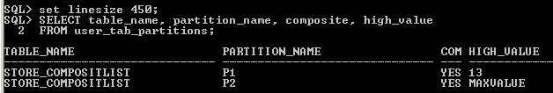
insert into store_compositlist values(11,'Reliance Fresh',500,'Al-khuwair','10-apr-17');
insert into store_compositlist values(12,'Reliance Fresh',450,'Sumail','12-sep-17');
insert into store_compositlist values(13,'Spencer Plaza',600,'Nizwa','11-Nov-17');
insert into store_compositlist values(14, 'Apollo Medical',300,'Ruwi','21-Jun-17');
insert into store_compositlist values(15,'Apollo Medical',800,'Ruwi','27-may-17');
Display the partition Information
set linesize 450;
SELECT table_name, partition_name, composite, high_value
FROM user_tab_partitions;
Dr.Girija Narasimhan

Slide 66
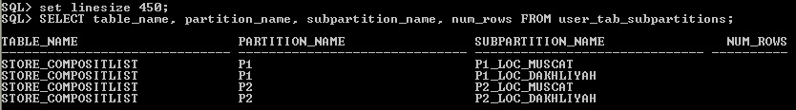
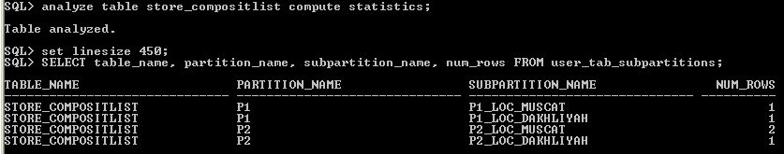
Display the sub partition information
SELECT table_name, partition_name, subpartition_name, num_rows FROM user_tab_subpartitions;
Here Num_rows column is empty. For getting values in the Num_rows column analyze the statistics.
Dr.Girija Narasimhan

Slide 67
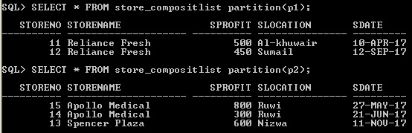
Display the Partition values in the partition P1 and P2
Dr.Girija Narasimhan

Slide 68
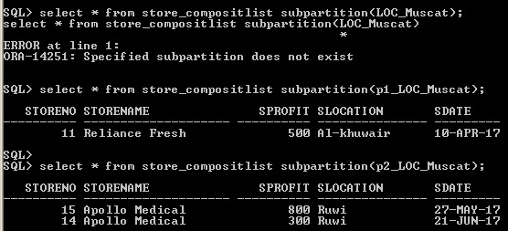
Display the Sub Partition values, don’t give sub partition name, then it will give error message. <partition name> _<subpartition name> in the select statement
Dr.Girija Narasimhan

Slide 69
PARTITIONED INDEX
Dr.Girija Narasimhan

Slide 70
Partition Index
A partitioned index in Oracle 11g is simply an index broken into multiple pieces.
By breaking an index into multiple physical pieces, you are accessing much smaller pieces (faster), and you may separate the pieces onto different disk drives (reducing I/O contention).
The primary objective of Oracle partitioning is to achieve better performance by excluding large volumes of data from query searches.
Either way, the cost-based optimizer must be used. Partitioning adds many possibilities to help improve performance and increase maintainability.
Dr.Girija Narasimhan

Slide 71
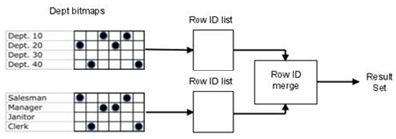
Partitioning can work several different ways.
The tables can be partitioned and the indexes are not partitioned;
Both the table and index are partitioned.
The tables not partitioned but indexes are partitioned;
Global Non-Partitioned Indexes
Local Indexes
Global Partitioned Indexes
adding new partitions, dropping, splitting, moving, merging, truncating, and optionally compressing partitions. Mainly OLTP environment.
1:1 relationship
range or hash partitioning
For example, assume we wanted to find old blue Toyota Corollas manufactured in 2015
If bitmap indexes are used, they must be local indexes
A table can have any number or combination of the different types of indexes built on its columns. B-tree indexes are most commonly used in a data warehouse to enforce unique keys.
Hash indexes cannot be partitioned.
Dr.Girija Narasimhan

Slide 72
There are two types of partitioned indexes.
local
global
An index on a partition is known as Local Index
while an index which applies to a full table is known as a Global Index.
Each type has two subsets, prefixed and non-prefixed.
Local Non-Prefixed Indexes
Local Prefixed Indexes
indexed column match the partition key
indexed column does not match the partition key
Dr.Girija Narasimhan

Slide 73
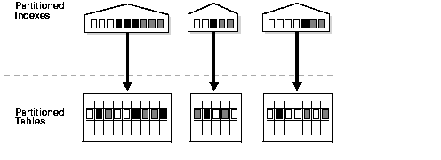
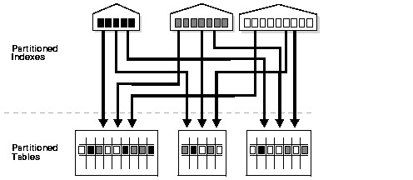
Partitioned Indexes types – local and global
Local Partitioned Index
Global Partitioned Index
Dr.Girija Narasimhan

Slide 74
Partitioned Indexes
Local Index
Global Index
one-to-one mapping between a index partition and a table partition (equipartitioned)
created with the LOCAL keyword and support partition independence
one-to-many relationship, allowing one index partition to map to many table partitions
Drop a non-empty global index partition will cause the next highest partition to be marked unusable.
index partition gets deleted when the underlying table partition dropped, can’t drop partition index
At least one partition should have MAX VALUE
number of index partitions will match the number of partitions in the base table.
Global Index don’t have Non-prefixed Indexes
Column mentioned in the partition index is not primary key column but it must be “NOT NULL” column.
Local Index allow both prefix and non-prefix indexes
Dr.Girija Narasimhan

Slide 75
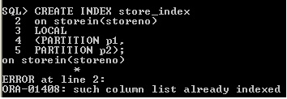
Local Index
CREATE INDEX <index_name>
ON <table_name> <column_name_list>
LOCAL
Partition(partition name);
Same partition name as given in the table.
The primary key column not allowed for indexing
Dr.Girija Narasimhan

Slide 76
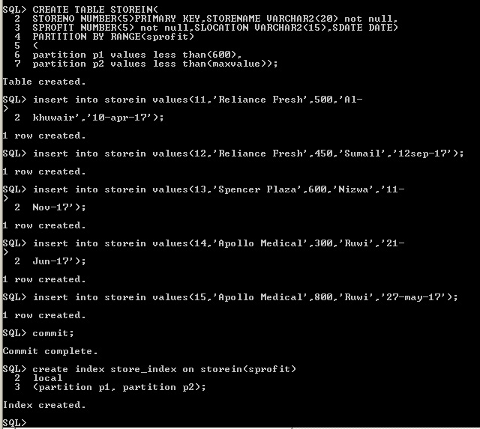
Local Prefixed Indexes
Dr.Girija Narasimhan

Slide 77
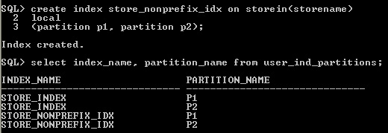
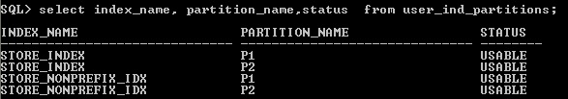
Local Non-Prefixed Indexes
Display the Status of the partition index
Dr.Girija Narasimhan

Slide 78
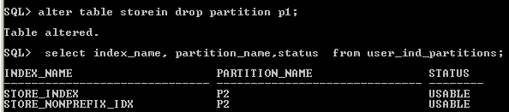
Dropping the Partition from the Local index is not allowed.
Instead of dropping from index, drop the partition from the table, it automatically drop the partition from the index.
Dr.Girija Narasimhan

Slide 79
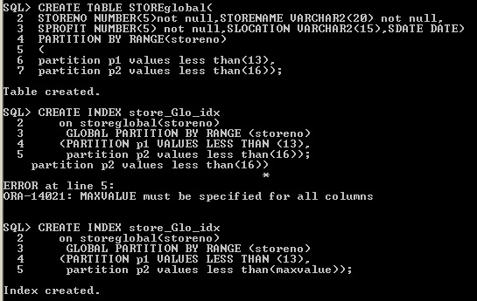
Global Index
In the global index max value should be include in partition.
Dr.Girija Narasimhan

Slide 80
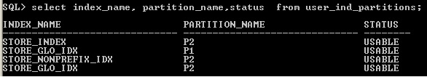
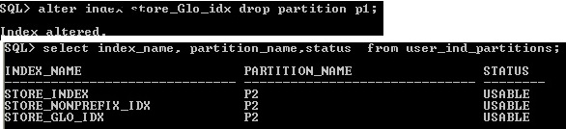
Display the status of the global index
Unlike local index, it is possible to remove or drop partition from the global index
Dr.Girija Narasimhan

Slide 81
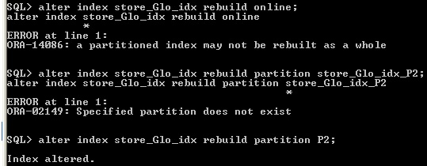
Entire global index can’t be rebuild, only specific partition to be rebuild is possible.
Partition name actual name given in the index no need to mention indexname_partition name.
Dr.Girija Narasimhan

Slide 82
References
https://www.morganslibrary.org/reference/partitions.html#rlp
http://www.acehints.com/2011/06/global-index-vs-local-index-difference.html
https://oracle-base.com/articles/8i/partitioned-tables-and-indexes
Reference:
https://logicalread.com/oracle-11g-partitioned-indexes-mc02/#.Wp5furpuKM8
https://docs.oracle.com/cd/B28359_01/server.111/b28313/indexes.htm#CHDDDFEG
Dr.Girija Narasimhan

